Slide 1
TensorFlow
An open-source software library for Machine Intelligence

Slide 2
Contents
What is TensorFlow?
Basic concept
Basic operation
Linear model
Loss
Optimizer
Train

Slide 3
What is TensorFlow?
TensorFlow was originally developed by researchers and engineers working on the Google Brain Team within Google's Machine Intelligence research organization for the purposes of conducting machine learning and deep neural networks research, but the system is general enough to be applicable in a wide variety of other domains as well.

Slide 4
What is TensorFlow?
TensorFlow™ is an open source software library for numerical computation using data flow graphs. Nodes in the graph represent mathematical operations, while the graph edges represent the multidimensional data arrays (tensors) communicated between them. The flexible architecture allows you to deploy computation to one or more CPUs or GPUs in a desktop, server, or mobile device with a single API.

Slide 5
Basic concept
Tensor
A tensor consists of a set of primitive values shaped into an array of any number of dimensions.
Here are some examples of tensors:
[1. ,2., 3.] # a rank 1 tensor; this is a vector with shape [3]
A tensor's rank is its number of dimensions.
3 # a rank 0 tensor; this is a scalar with shape []
[1. ,2., 3.] # a rank 1 tensor; this is a vector with shape [3]
[[1., 2., 3.], [4., 5., 6.]] # a rank 2 tensor; a matrix with shape [2, 3]
[[[1., 2., 3.]], [[7., 8., 9.]]] # a rank 3 tensor with shape [2, 1, 3]

Slide 6
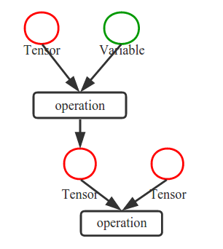
Basic concept
Flow
Nodes in the graph represent mathematical operations, while the graph edges represent the multidimensional data arrays (tensors) communicated between them.

Slide 7
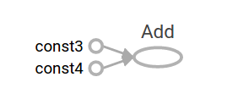
Basic operation
Add
const3=tf.constant(3.0,dtype=tf.float32)
print(const3)
const4=tf.constant(4.0,dtype=tf.float32)
print(const4)
const5=const3+const4
print(const5)
print(sess.run(const5))

Slide 8
Basic operation
Placeholder
As it stands, this graph is not especially interesting because it always produces a constant result. A graph can be parameterized to accept external inputs, known as placeholders. A placeholder is a promise to provide a value later.
a = tf.placeholder(tf.float32)
b = tf.placeholder(tf.float32)
adder_node = a + b # + provides a shortcut for tf.add(a, b)
The preceding three lines are a bit like a function or a lambda in which we define two input parameters (a and b) and then an operation on them. We can evaluate this graph with multiple inputs by using the feed_dict parameter to specify Tensors that provide concrete values to these placeholders:
print(sess.run(adder_node, {a: 3, b:4.5}))
print(sess.run(adder_node, {a: [1,3], b: [2, 4]}))

Slide 9
Linear model
Variables
In machine learning we will typically want a model that can take arbitrary inputs, such as the one above. To make the model trainable, we need to be able to modify the graph to get new outputs with the same input. Variables allow us to add trainable parameters to a graph. They are constructed with a type and initial value:
W = tf.Variable([.3], dtype=tf.float32)
b = tf.Variable([-.3], dtype=tf.float32)
x = tf.placeholder(tf.float32)
linear_model = W * x + b

Slide 10
Loss
We've created a model, but we don't know how good it is yet. To evaluate the model on training data, we need a y placeholder to provide the desired values, and we need to write a loss function.
A loss function measures how far apart the current model is from the provided data. We'll use a standard loss model for linear regression, which sums the squares of the deltas between the current model and the provided data. linear_model - y creates a vector where each element is the corresponding example's error delta. We call tf.square to square that error. Then, we sum all the squared errors to create a single scalar that abstracts the error of all examples using tf.reduce_sum:
y = tf.placeholder(tf.float32)
squared_deltas = tf.square(linear_model - y)
loss = tf.reduce_sum(squared_deltas)
print(sess.run(loss, {x:[1,2,3,4], y:[0,-1,-2,-3]}))

Slide 11
Optimizer
A complete discussion of machine learning is out of the scope of this tutorial. However, TensorFlow provides optimizersthat slowly change each variable in order to minimize the loss function. The simplest optimizer is gradient descent. It modifies each variable according to the magnitude of the derivative of loss with respect to that variable. In general, computing symbolic derivatives manually is tedious and error-prone. Consequently, TensorFlow can automatically produce derivatives given only a description of the model using the function tf.gradients. For simplicity, optimizers typically do this for you. For example,
optimizer = tf.train.GradientDescentOptimizer(0.01)

Slide 12
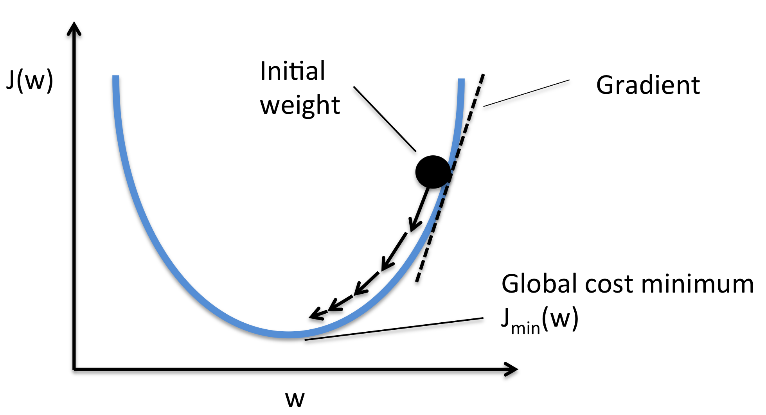
Train
train = optimizer.minimize(loss)
sess.run(init) # reset values to incorrect defaults.
for i in range(1000):
sess.run(train, {x:[1,2,3,4], y:[0,-1,-2,-3]})
print(sess.run([W, b]))

Slide 13
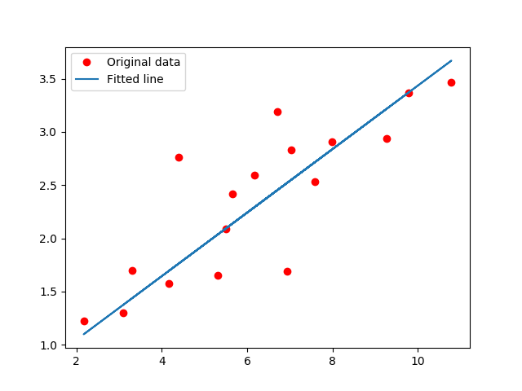
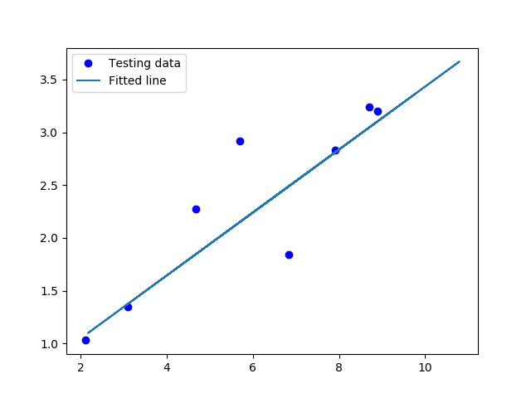
Train
linear regression in TensorFlow-Examples

Slide 14
references
https://www.bbsmax.com/A/VGzlM3aVJb/
https://www.tensorflow.org/get_started/get_started#importing_tensorflow
https://en.wikipedia.org/wiki/Gradient_descent
https://github.com/aymericdamien/TensorFlow-Examples
https://www.tensorflow.org/

