Slide 1
Recurrent Neural Networks
循环神经网络

Slide 2
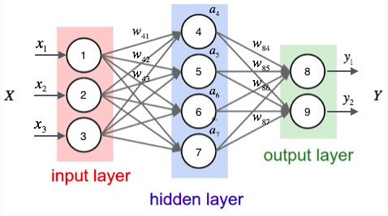
Neural Networks

Slide 3
Recurrent Neural Networks
Humans don’t start their thinking from scratch every second. As you read this essay, you understand each word based on your understanding of previous words. You don’t throw everything away and start thinking from scratch again. Your thoughts have persistence.

Slide 4
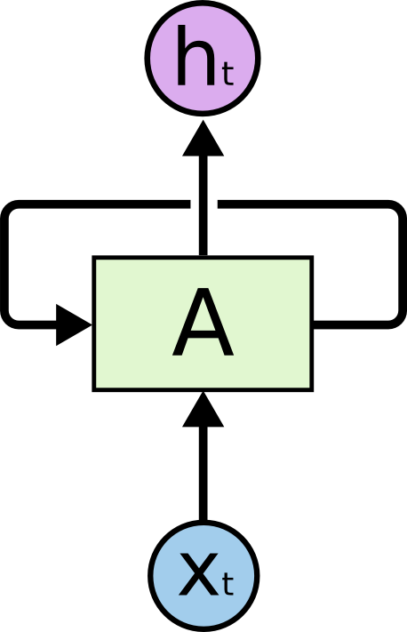
Recurrent Neural Networks

Slide 5
Recurrent Neural Networks

Slide 6
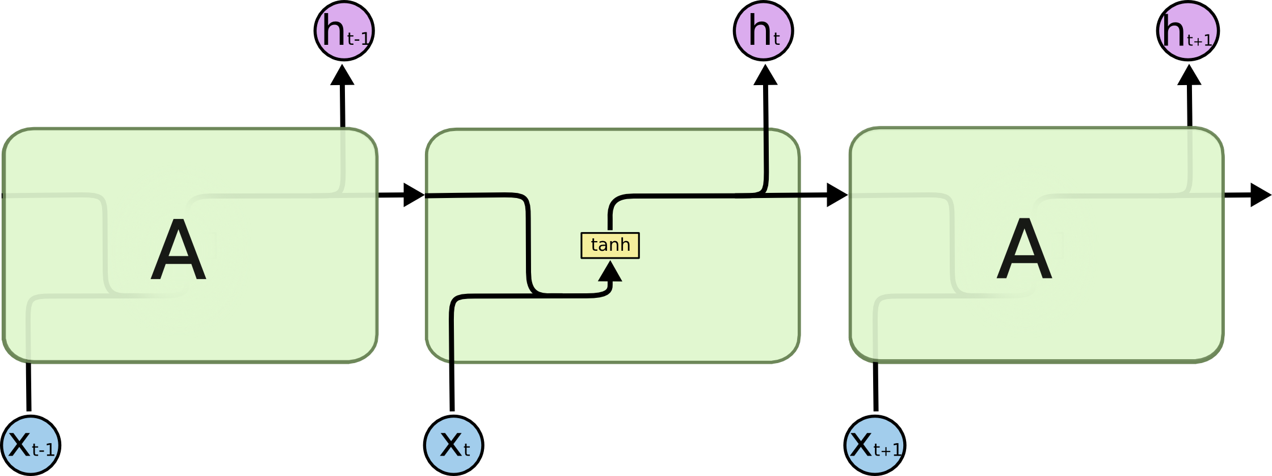
RNN cell

Slide 7
The Problem of Long-Term Dependencies
One of the appeals of RNNs is the idea that they might be able to connect previous information to the present task, such as using previous video frames might inform the understanding of the present frame. If RNNs could do this, they’d be extremely useful.
But can they? It depends.

Slide 8
The Problem of Long-Term Dependencies
Sometimes, we only need to look at recent information to perform the present task. For example, consider a language model trying to predict the next word based on the previous ones. If we are trying to predict the last word in “the clouds are in the sky,” we don’t need any further context – it’s pretty obvious the next word is going to be sky. In such cases, where the gap between the relevant information and the place that it’s needed is small, RNNs can learn to use the past information.

Slide 9
LSTM Networks
LSTMs also have this chain like structure, but the repeating module has a different structure. Instead of having a single neural network layer, there are four, interacting in a very special way.

Slide 10
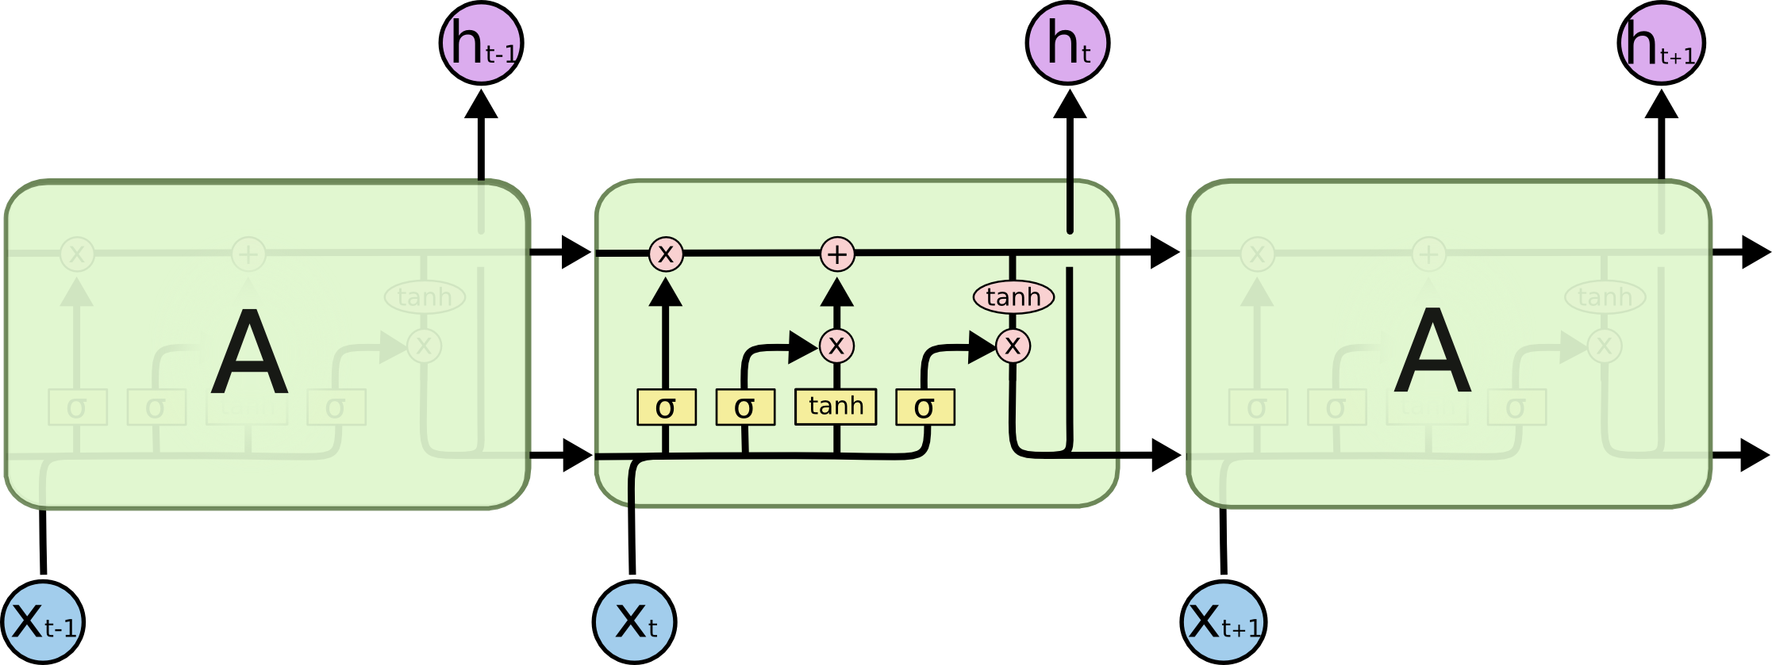
LSTM cell

Slide 11
cnn-text-classification-tf
Convolutional Neural Network for Text Classification in Tensorflow
https://github.com/dennybritz/cnn-text-classification-tf We report on a series of experiments with convolutional neural networks (CNN) trained on top of pre-trained word vectors for sentence-level classification tasks. We show that a simple CNN with little hyperparameter tuning and static vectors achieves excellent results on multiple benchmarks. Learning task-specific vectors through fine-tuning offers further gains in performance. We additionally propose a simple modification to the architecture to allow for the use of both task-specific and static vectors. The CNN models discussed herein improve upon the state of the art on 4 out of 7 tasks, which include sentiment analysis and question classification.

Slide 12
Movie Review Data
This page is a distribution site for movie-review data for use in sentiment-analysis experiments. Available are collections of movie-review documents labeled with respect to their overall sentiment polarity (positive or negative) or subjective rating (e.g., "two and a half stars") and sentences labeled with respect to their subjectivity status (subjective or objective) or polarity. These data sets were introduced in the following papers:
http://www.cs.cornell.edu/people/pabo/movie-review-data/

