Slide 1
Convolutional Neural Networks for Sentence Classification

Slide 2
Abstract
We report on a series of experiments with convolutional neural networks (CNN) trained on top of pre-trained word vectors for sentence-level classification tasks.
We show that a simple CNN with little hyperparameter tuning and static vectors achieves excellent results on multiple benchmarks. Learning task-specific vectors through fine-tuning offers further gains in performance.
We additionally propose a simple modification to the architecture to allow for the use of both task-specific and static vectors. The CNN models discussed herein improve upon the state of the art on 4 out of 7 tasks, which include sentiment analysis and question classification.

Slide 3
Data
The dataset we’ll use in this post is the Movie Review data from Rotten Tomatoes – one of the data sets also used in the original paper.
The dataset contains 10,662 example review sentences, half positive and half negative. The dataset has a vocabulary of size around 20k. Note that since this data set is pretty small we’re likely to overfit with a powerful model. Also, the dataset doesn’t come with an official train/test split, so we simply use 10% of the data as a dev set. The original paper reported results for 10-fold cross-validation on the data.

Slide 4
Data Sample
negative:
simplistic , silly and tedious .
it's so laddish and juvenile , only teenage boys could possibly find it funny .
exploitative and largely devoid of the depth or sophistication that would make watching such a graphic treatment of the crimes bearable .
[garbus] discards the potential for pathological study , exhuming instead , the skewed melodrama of the circumstantial situation .
a visually flashy but narratively opaque and emotionally vapid exercise in style and mystification .
the story is also as unoriginal as they come , already having been recycled more times than i'd care to count .
positive:
the rock is destined to be the 21st century's new " conan " and that he's going to make a splash even greater than arnold schwarzenegger , jean-claud van damme or steven segal .
the gorgeously elaborate continuation of " the lord of the rings " trilogy is so huge that a column of words cannot adequately describe co-writer/director peter jackson's expanded vision of j . r . r . tolkien's middle-earth .
effective but too-tepid biopic
if you sometimes like to go to the movies to have fun , wasabi is a good place to start .

Slide 5
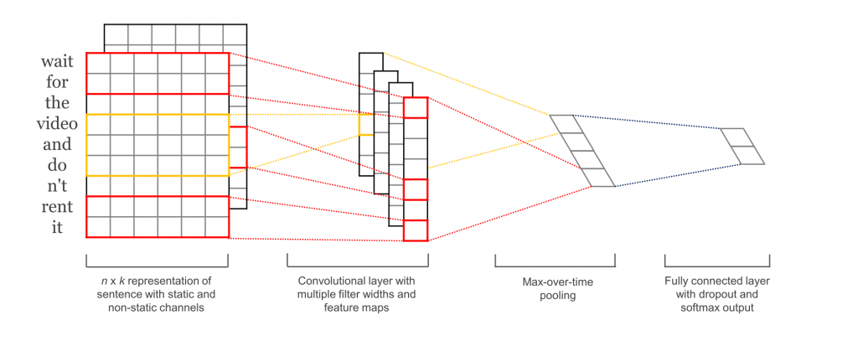
Model

Slide 6
Variations
Model Variations We experiment with several variants of the model.
• CNN-rand: Our baseline model where all words are randomly initialized and then modified during training.
• CNN-static: A model with pre-trained vectors from word2vec. All words— including the unknown ones that are randomly initialized—are kept static and only the other parameters of the model are learned.
• CNN-non-static: Same as above but the pretrained vectors are fine-tuned for each task.
• CNN-multichannel: A model with two sets of word vectors. Each set of vectors is treated as a ‘channel’ and each filter is applied to both channels, but gradients are backpropagated only through one of the channels. Hence the model is able to fine-tune one set of vectors while keeping the other static. Both channels are initialized with word2vec.

Slide 7
Results of our CNN models against other methods.
RAE: Recursive Autoencoders with pre-trained word vectors from Wikipedia (Socher et al., 2011).
MV-RNN: Matrix-Vector Recursive Neural Network with parse trees (Socher et al., 2012).
RNTN: Recursive Neural Tensor Network with tensor-based feature function and parse trees (Socher et al., 2013).
DCNN:Dynamic Convolutional Neural Network with k-max pooling (Kalchbrenner et al., 2014). Paragraph-Vec: Logistic regression on top of paragraph vectors (Le and Mikolov, 2014).
CCAE: Combinatorial Category Autoencoders with combinatorial category grammar operators (Hermann and Blunsom, 2013).
Sent-Parser: Sentiment analysis-specific parser (Dong et al.,2014).
NBSVM, MNB: Naive Bayes SVM and Multinomial Naive Bayes with uni-bigrams from Wang and Manning (2012).
G-Dropout, F-Dropout: Gaussian Dropout and Fast Dropout from Wang and Manning (2013). Tree-CRF: Dependency tree with Conditional Random Fields (Nakagawa et al., 2010).
CRF-PR: Conditional Random Fields with Posterior Regularization(Yang and Cardie, 2014).
SVMS: SVM with uni-bi-trigrams, wh word, head word, POS, parser, hypernyms, and 60 hand-coded rules as features from Silva et al. (2011).

Slide 8
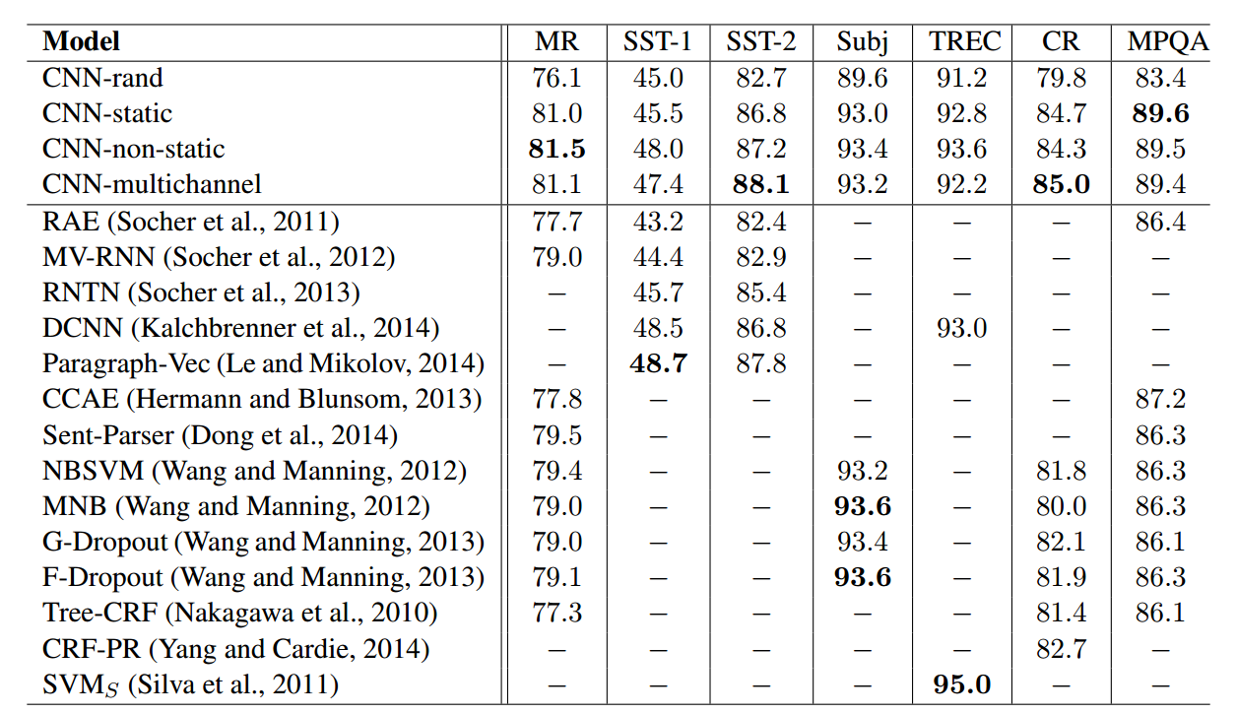
Benchmarks

Slide 9
Conclusion
In the present work we have described a series of experiments with convolutional neural networks built on top of word2vec. Despite little tuning of hyperparameters, a simple CNN with one layer of convolution performs remarkably well. Our results add to the well-established evidence that unsupervised pre-training of word vectors is an important ingredient in deep learning for NLP.

Slide 10
References
https://arxiv.org/abs/1408.5882
http://www.wildml.com/2015/12/implementing-a-cnn-for-text-classification-in-tensorflow/
http://www.cs.cornell.edu/people/pabo/movie-review-data/
https://github.com/dennybritz/cnn-text-classification-tf
https://github.com/yoonkim/CNN_sentence

